Slide 1
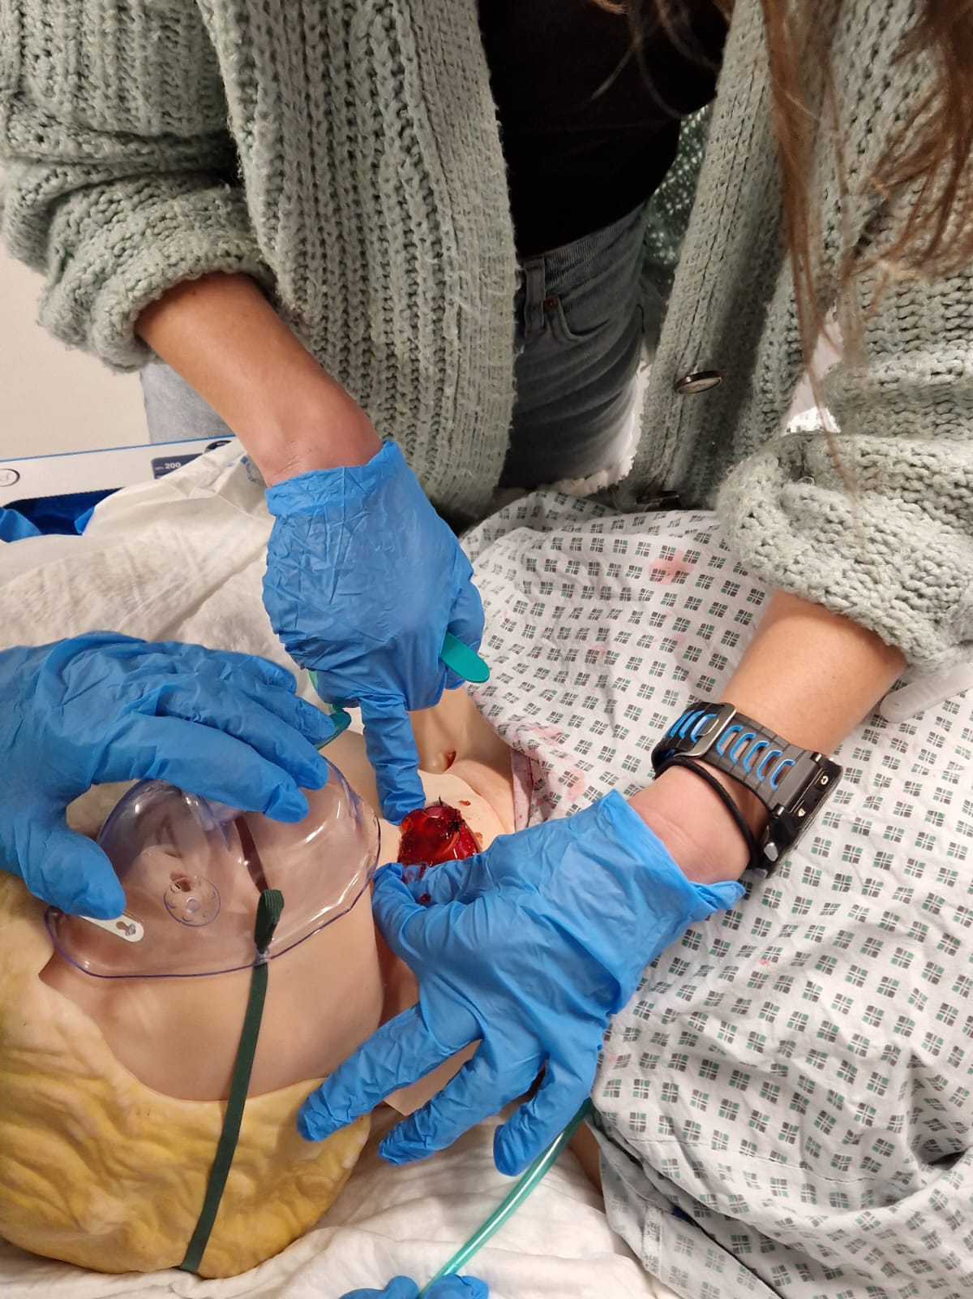
Introducing Post Thyroid Surgery Haematoma Guidelines Simulation training in University Hospital of Wales, Cardiff By Dr Owen Vale (ST7 Anaesthetics UHW), Dr Andrew Hadfield (Consultant Anaesthetics UHW), Dr Catrin Maidment (Consultant Anaesthetics UHW) Institution – University Hospital of Wales Cardiff
Introduction
New guidelines were produced in 2021 for the management of suspected haematoma following thyroid surgery.¹ These guidelines were in partnership with DAS (Difficult airway society), BAETS (British Association of Endocrine and Thyroid Surgeons), and ENT UK. The aim of these guidelines was to improve safety of perioperative care of patients having thyroid surgery.¹
Post-operative haemorrhage is a recognised complication post thyroid surgery and occurs in 1-5% of patients. As a haematoma develops this causes pressure in the neck to increase. Rarely is the trachea obstructed by the haematoma but it can be deviated. The pressure however impairs venous return which leads to progressive laryngeal oedema. Opening the surgical neck wound releases the pressure and the venous congestion preventing worsening laryngeal oedema, optimising conditions, and will increase the likelihood of successful intubation if required.¹
The guidelines suggest that organisations offering thyroid surgery should support MDT members to acquire the competencies and skills required to manage acute complications post thyroid surgery. Staff should have the training to recognise and manage post thyroid surgery haematomas and teaching should focus on anatomy and simulation. The guidelines also suggest that teaching should enable staff to familiarise themselves with the contents of the post thyroid surgery emergency box which should be located at the bedside of each post thyroid surgery patient and should accompany the patient when transferred.¹
Method
Overall we are aiming to accomplish an improved awareness and familiarisation with the new management of post thyroid surgery haematoma guidelines. This was broken down further:
To increase awareness of the new Management of Post thyroid surgery haematoma guideline
To improve trainees’ confidence at managing a post thyroid surgery haematoma
To improve the understanding of the required actions of how to manage a patient with a post thyroid surgery haematoma
To develop a simulation mannequin to enable a simulation of a patient with a post thyroid surgery haematoma
As part of our departmental workshops we provided a classroom based lecture presentation covering the new guideline, basic anatomy, and the post thyroid surgery emergency box. This was then followed by two clinical simulation scenarios to enable the trainees to practice and familiarise themselves with managing the patient following the guideline and using the post thyroid surgery haematoma emergency box.
A questionnaire was produced and completed by all trainees assessing their awareness, understanding and confidence in managing a post thyroid haematoma before and after a PowerPoint teaching session and a post thyroid surgery simulation.
A mannequin was created to simulate a neck haematoma which candidates could open and evacuate according to the new guideline. We designed a scenario of a patient in recovery deteriorating post thyroid surgery, which allowed the candidates to practice this procedure whilst immersed in a dynamically changing clinical environment.
Equipment used to create the simulation mannequin
2. To improve trainee’s confidence at managing a post thyroid surgery haematoma
Trainees showed an improvement in confidence after teaching of managing a patient with a haematoma post thyroid surgery. There was a global increase in confidence within the group with 100% (15/15) of trainees having a confidence in haematoma management before teaching of 0-2/5. When compared to the confidence in the group manging this situation after teaching 100% (15/15) recorded a confidence in managing post thyroid surgery between 3-5/5. This is illustrated below.
 | Mannequin Equipment Required
1 | Resuscitation dummy
2 | Simulation foam skin 20x15cm with a 9cm surgical incision in its centre
3 | Size 5 proseal LMA
4 | simulation strap muscles
5 | Oxygen tubing to attach to 50ml syringe 160cm
6 | 50ml syringe
7 | Red jelly in solid and liquid form
8 | Silk suture 2-0
9 | Tape
10 | Hospital gown
11 | Oxygen mask
12 | Oxygen tubing for oxygen mask
The oxygen tubing was placed in the gastric aspiration port of the proseal LMA and was attached to the 50ml syringe. These were then threaded under the top layer of the mannequin so that the mask of the proseal LMA was at the level of the larynx on the mannequin. Jelly was then placed in the mask of the proseal LMA. The simulation strap muscles were sutured together using interrupted sutures to form a cylinder and placed over the mask of the LMA so that the LMA intubates the simulation strap muscles. A surgical cut of 9cm was made in a rectangle of simulation skin 20x15cm and the surgical cut was sutured together using a continuous suture.
Steri-strips were then placed over the surgical wound. The simulation skin was then placed over the neck to cover the LMA with the top and bottom of the skin tucked into the mannequin and the sides taped down.
During the scenario the 50ml syringe was filled with liquid water jelly mix and injected through the oxygen tubing into the LMA to simulate blood loss. A post thyroid surgery box was also provided which contained, the management of post thyroid surgery haematoma/ SCOOP guidelines, sterile gauze, scissors, scalpel, and artery clip.
3. To improve the understanding of the required actions of how to manage a patient with a post thyroid surgery haematoma
In 100% (15/15) of trainees they felt that the teaching helped them to understand the required actions to manage a patient with a post thyroid surgery haematoma, and 100% (15/15) found the teaching to be a useful learning experience.
4. To develop a simulation mannequin to enable a simulation of a patient with a post thyroid surgery haematoma
 | Mannequin Feedback Received
1 | “Good sim set up!”
2 | “Great sim model”
3 | “Very useful and great use of props!”
4 | “Good use of sim to make it more realistic”
5 | “Great Sim model”,
6 | “Nice sim set up and props!”
7 | “Great session”
8 | “would love to attend further sessions”
9 | “Very useful”
10 | “Excellent”
Results
Data was collected from 15 trainees with training grades ranging from novice to ST5.
1. To increase awareness of the new Management of Post thyroid surgery haematoma guideline
Trainees showed an improvement in awareness of the new guidelines. Trainees awareness of the new guideline was 67% (10/15) prior to teaching with 33% (5/15) unaware of the new guideline. This awareness improved to 100% with the teaching.
A mannequin was produced and enabled simulation of the new guidelines. It enabled improved awareness of the guideline in 67% of trainees, it enabled 100% of trainees to obtain a better understanding of the required actions to manage a patient with a post thyroid surgery haematoma, and improved confidence with this. Feedback comments from the trainees on the mannequin is shown. No negative feedback was received.
Conclusion
Overall there was a 100% increase in confidence of managing post thyroid surgery haematoma and a 100% increase in understanding of actions required to manage a post thyroid surgery haematoma. We also increased awareness of the guideline within the group by 67%. This as well as the positive feedback received regarding the simulation mannequin suggests that the mannequin and scenario was suitable to enable simulation training on managing haematomas post thyroid surgery.
References
Management of haematoma after thyroid surgery: systematic review and multidisciplinary consensus guidelines from the Difficult Airway Society, the British Association of Endocrine and Thyroid Surgeons and the British Association of Otorhinolaryngology, Head and Neck Surgery: HA, Iliff. K, El-Boghdadly. I, Ahmad. J, Davis. A, Harris. S, Khan. V, Lan-Pak-Kee. J, O’Connor. L, Powell. G, Rees. TS, Tatla; Anaesthesia 2021 Jan;77(1):82-95
Picture above showing simulation in progress

